Slide 1
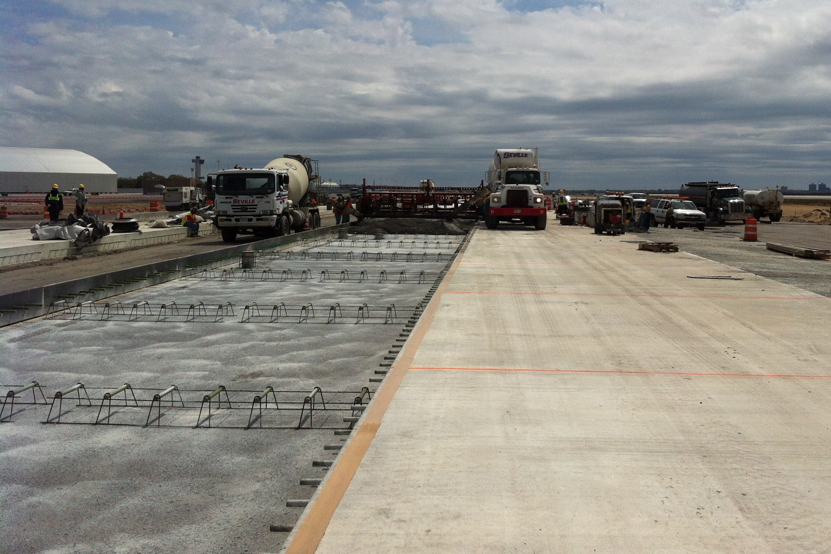
MDOT Field Inspection of Load Transfer Assemblies

Slide 2
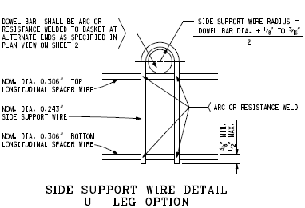
U – Leg Option
Arc or Resistance Welded Only
Top Spacer Wire – Dia. 0.306”
Support Wire – Dia. 0.243”
Bottom Spacer Wire – Dia. 0.306”
Top & Bottom Spacer Wire allowable length of 1½” (+/- ½”) from center of the dowel bar.

Slide 3
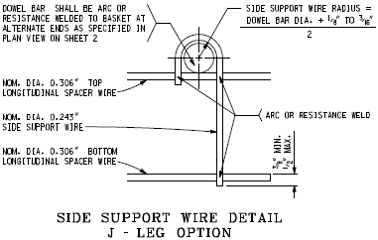
J – Leg Option
Arc or Resistance Welded Only
Top Spacer Wire – Dia. 0.306”
Support Wire – Dia. 0.243”
Bottom Spacer Wire – Dia. 0.306”
Top & Bottom Spacer Wire allowable length of 1½” (+/- ½”) from center of the dowel bar.

Slide 4
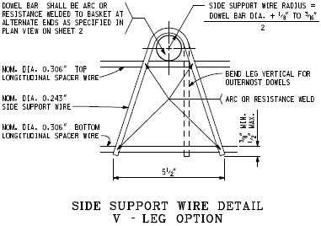
V – Leg Option
Arc or Resistance Welded Only
Top Spacer Wire – Dia. 0.306”
Support Wire – Dia. 0.243”
Bottom Spacer Wire – Dia. 0.306”
Top & Bottom Spacer Wire allowable length of 1½” (+/- ½”) from center of the dowel bar.

Slide 5
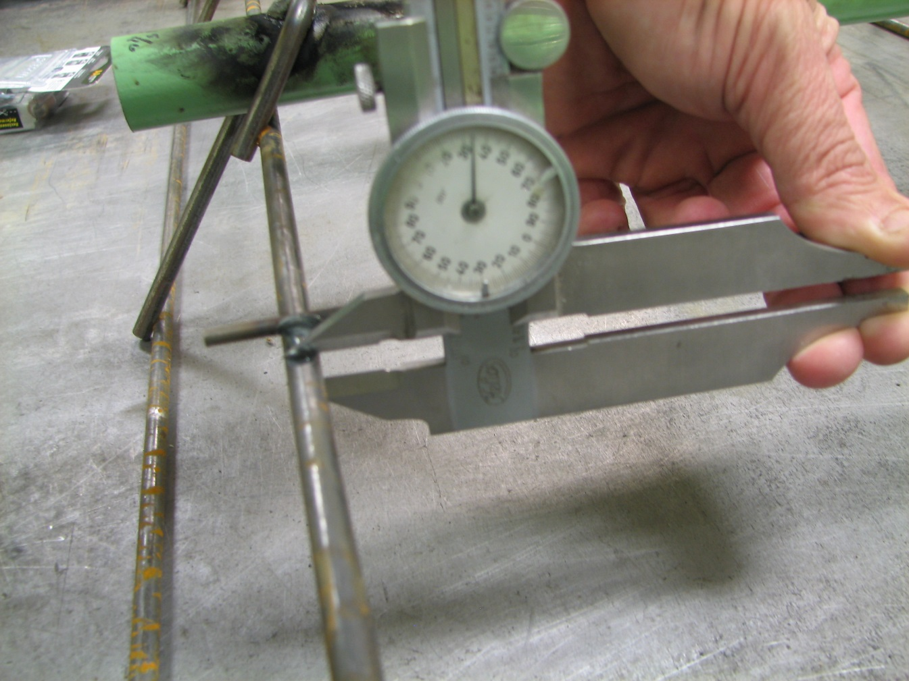
#1 Frame Rail Wire Tolerance
Side support Minimum diameter of 0.243”
Top & bottom spacer wires can have a minimum diameter of 0.303”

Slide 6
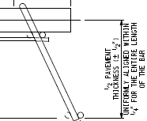
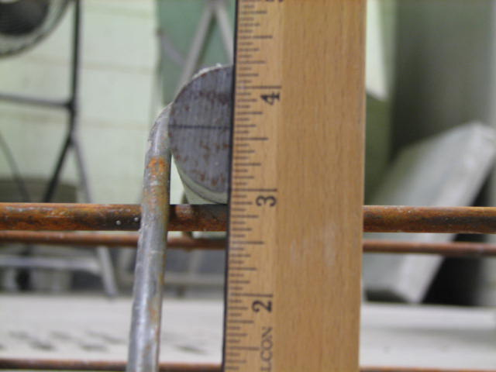
#2 Allowable Height of Bar
On any leg option, measure from flat surface on ground to center of dowel to determine if dowel is half the depth of pavement. Within (+/- ½”)

Slide 7
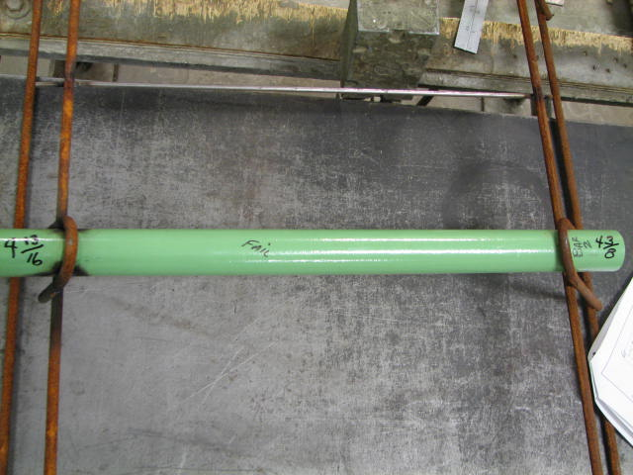
#2 Continued…
Dowel bars should be aligned within ¼” for the entire length of the bar.

Slide 8

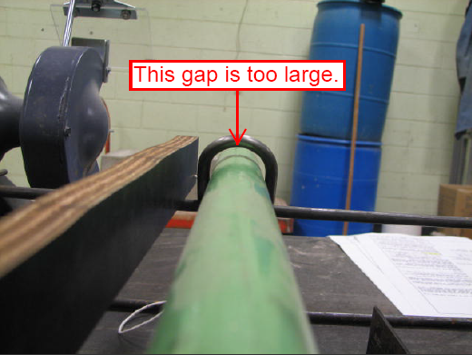
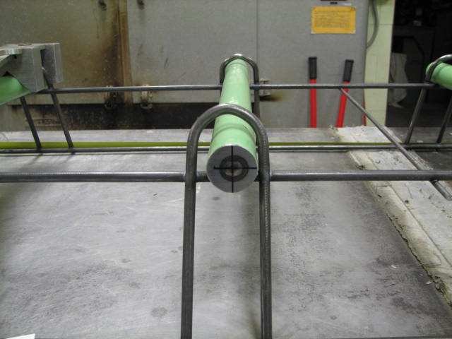
#3 Support Wire Radius
These gaps are in excess of the 3/16” tolerance in our Standard Plan.

Slide 9
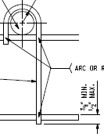
#4 Side Support Leg Tolerance
The top of the bottom spacer wire to the bottom of the support wire should be a minimum of 3/8” and a maximum 1/2”
The side support legs can extend slightly past the bottom spacer wire but not in excess of 3/16”

Slide 10
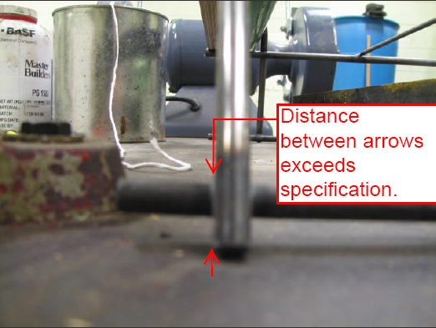
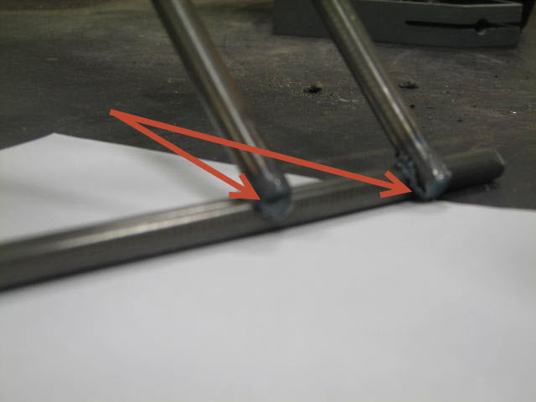
#4 Continued… Side Support Leg Failures
Not Ideal
Too Short

Slide 11
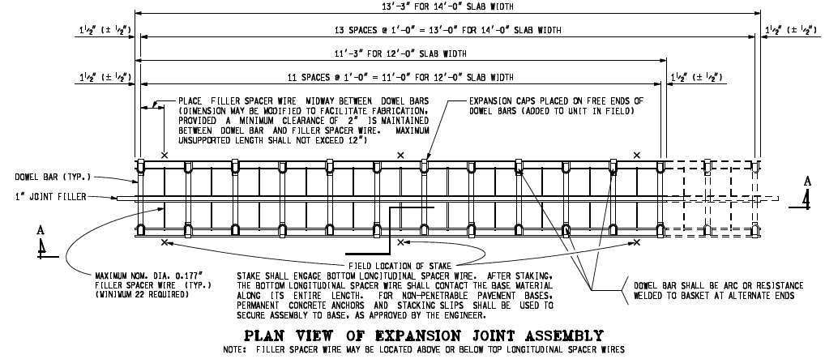
#5 Allowable Basket Length/Width and Tie Wires
13’-4” max for 14’-0” slab width
11’-4” max for 12’-0” slab width
22 filler spacer wires for 12’ slab
26 filler spacer wires for 14’ slab
Dowel bars shall be aligned parallel to each other in the assembly on 1’-0” (+/- ½”) centers.

Slide 12
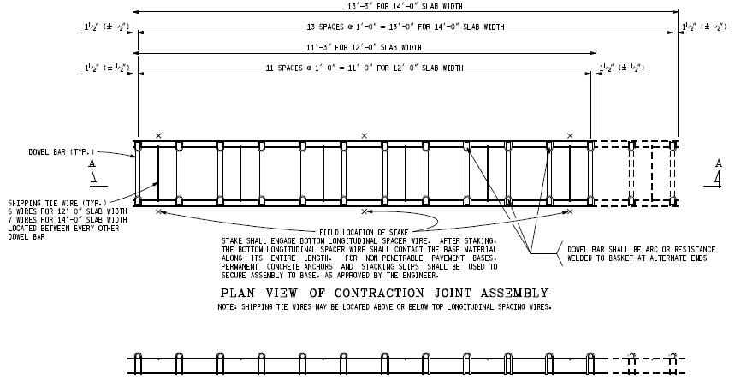
#5 Allowable Basket Length/Width and Tie Wires (continued)
13’-4” max for 14’-0” slab width
11’-4” max for 12’-0” slab width
6 tie wires for 12’ slab
7 tie wires for 14’ slab
Tie wires should be located every other dowel bar.
Dowel bars shall be aligned parallel to each other in the assembly on 1’-0” (+/- ½”) centers.

Slide 13
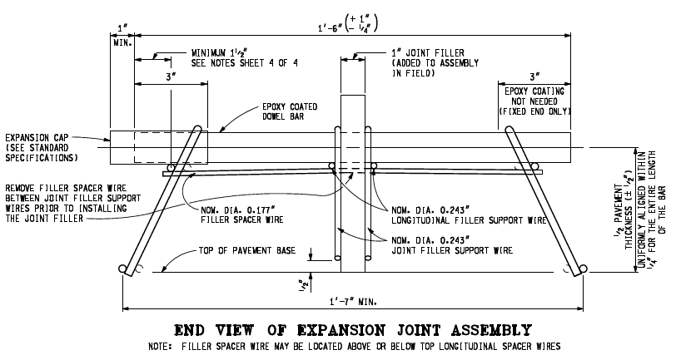
#5 Continued…
Dowel bar length should be between 17¾” and 19”
The maximum nominal diameter of the filler spacer wire is 0.177”
Minimum width of basket should be 1’-7” (19”).

Slide 14
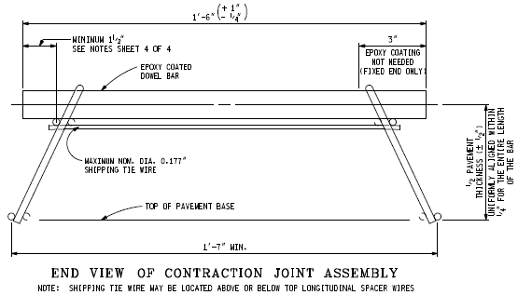
#5 Continued…
Dowel bar length should be between 17¾” and 19”
The maximum nominal diameter of the tie wire is 0.177”
Minimum width of basket should be 1’-7” (19”).

Slide 15
#6 Welds
All wire intersections are to be Arc or Resistance welded.
Some examples of bad welds are as followed:

Slide 16
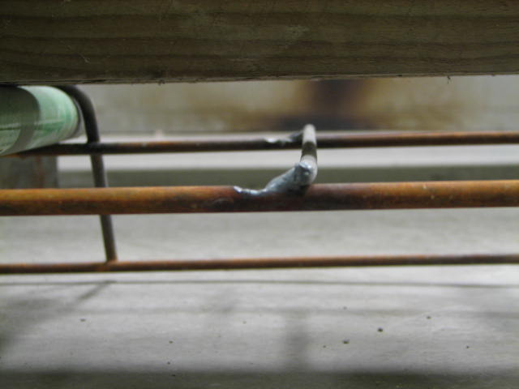
Bad weld on tie bar to top spacer wire

Slide 17
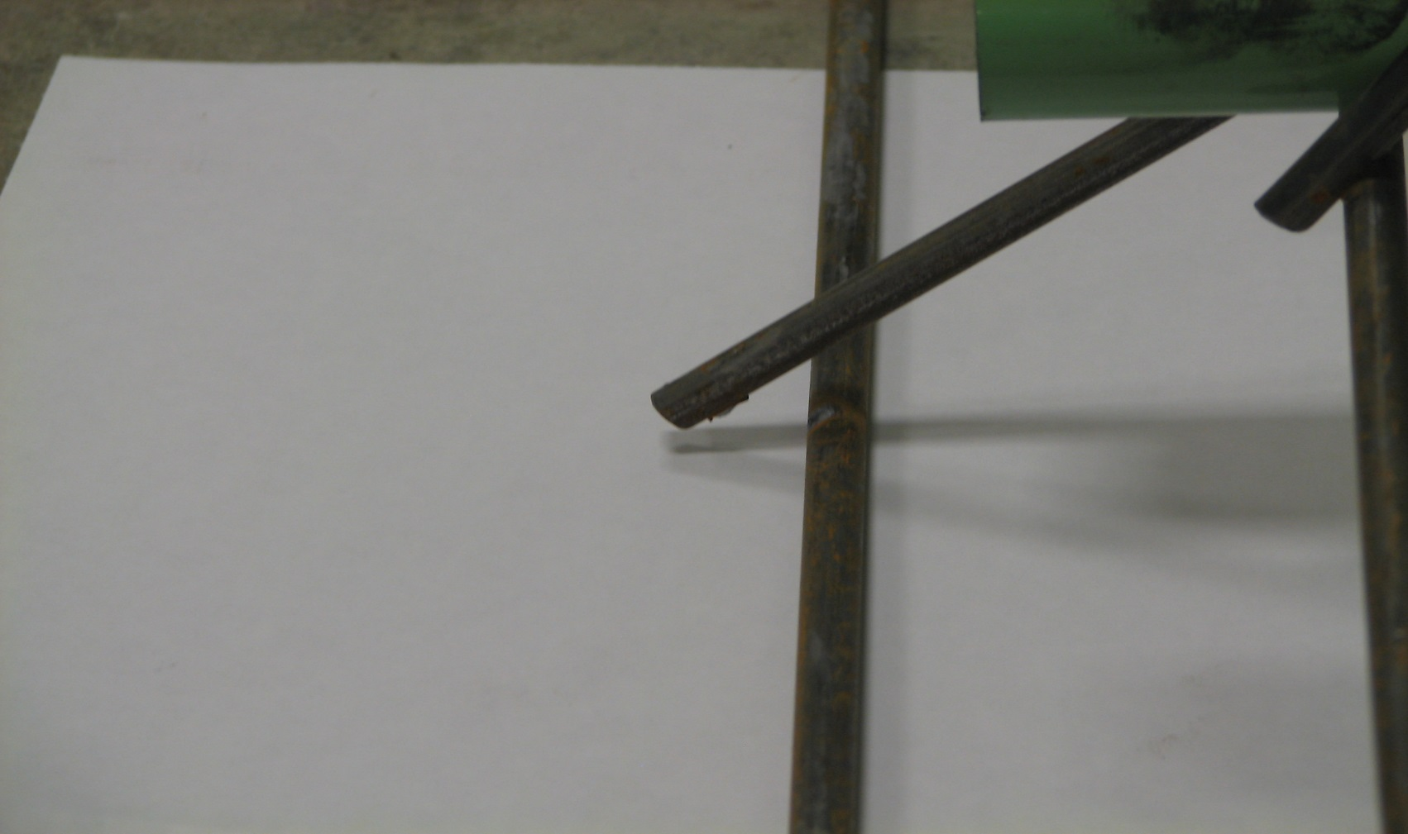
Bad weld on support leg to bottom spacer wire

Slide 18
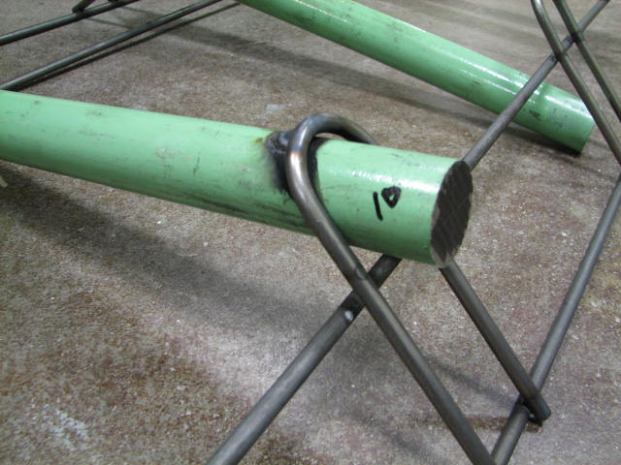
Bad weld on top spacer wire

